Slide 1
Fake News Presentation
A135 Team 5
NAME MATRICULATION NO NAME MATRICULATION NO NAME MATRICULATION NO

Slide 2




Table of Contents
1
Motivation
2
Exploratory Data Analysis and Visualization
3
Machine-Learning Models
4
Conclusion

Slide 3

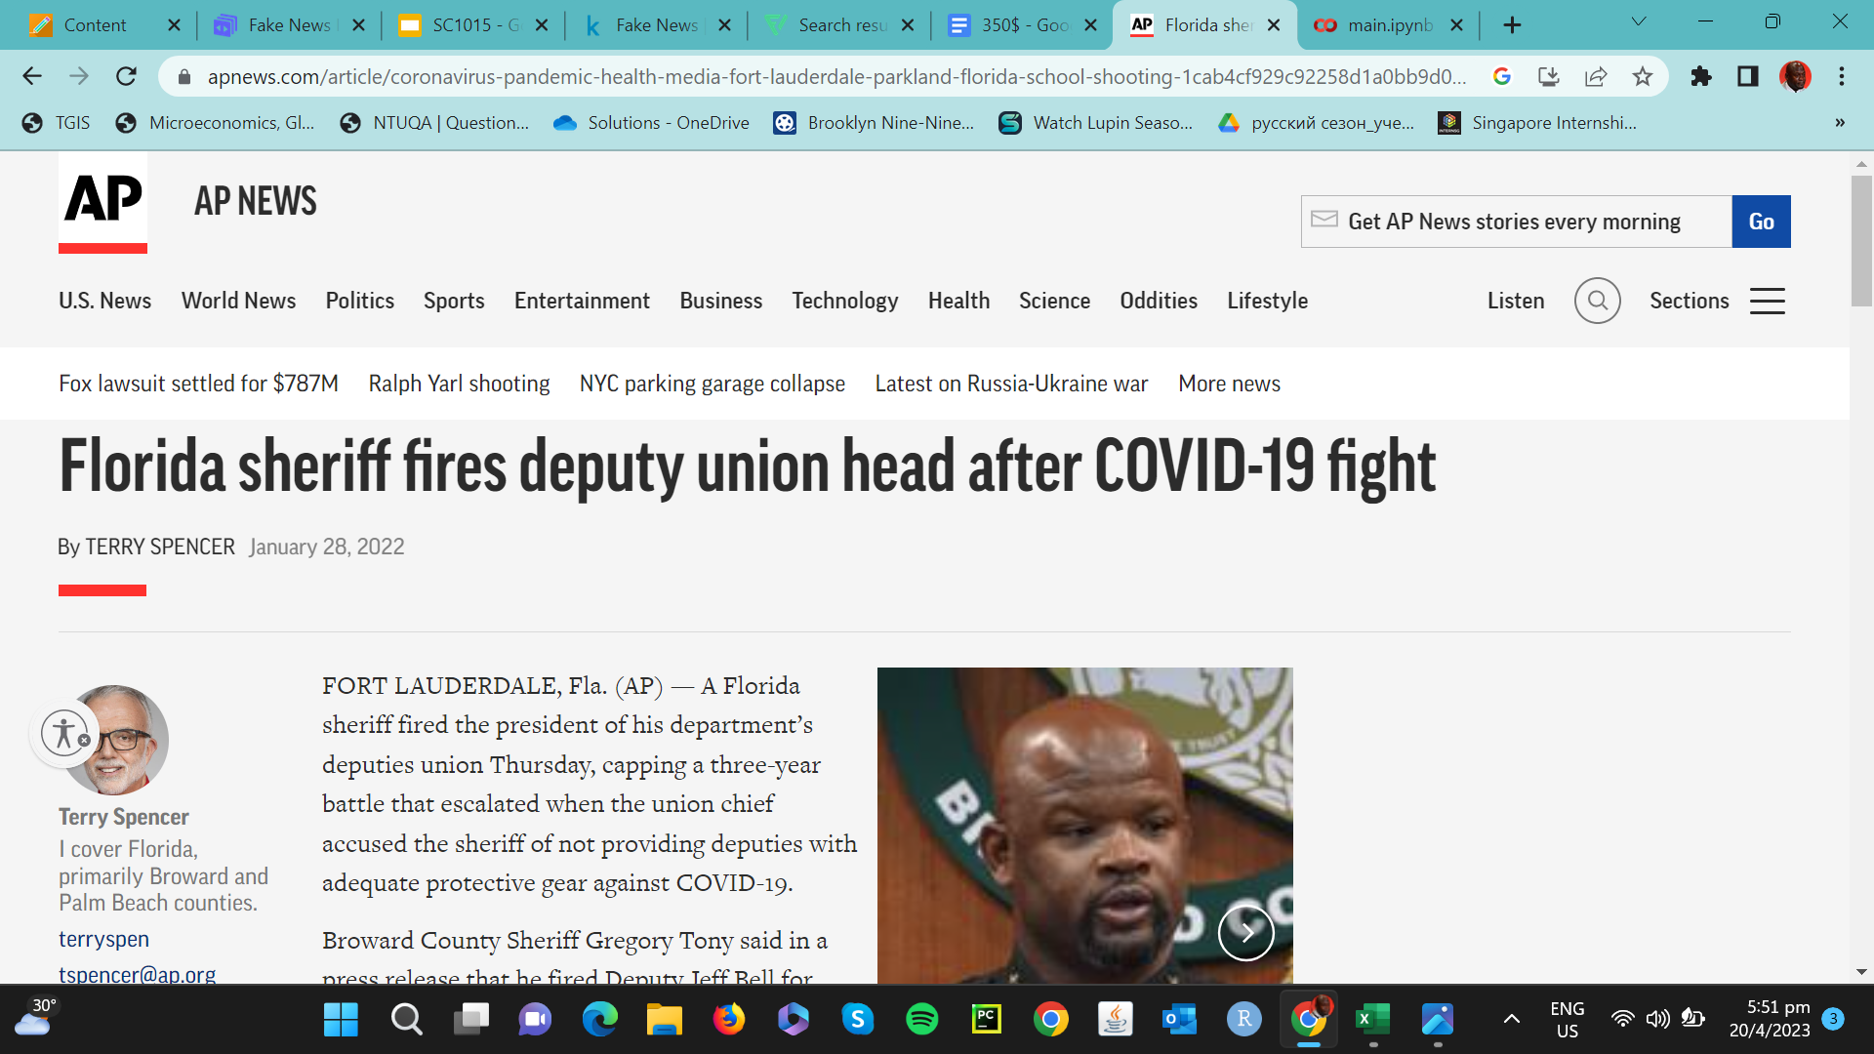
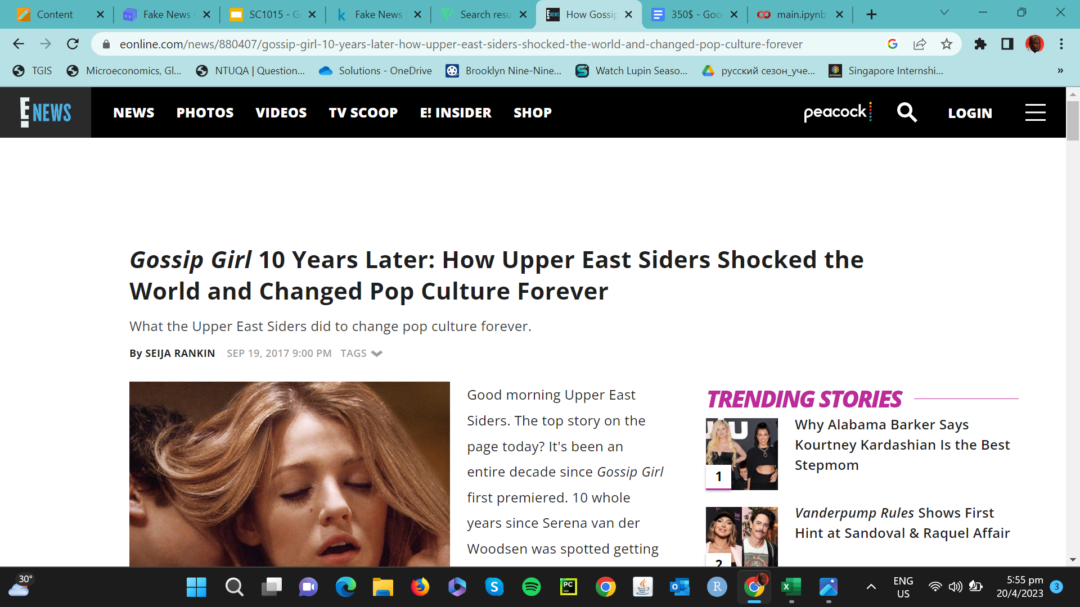
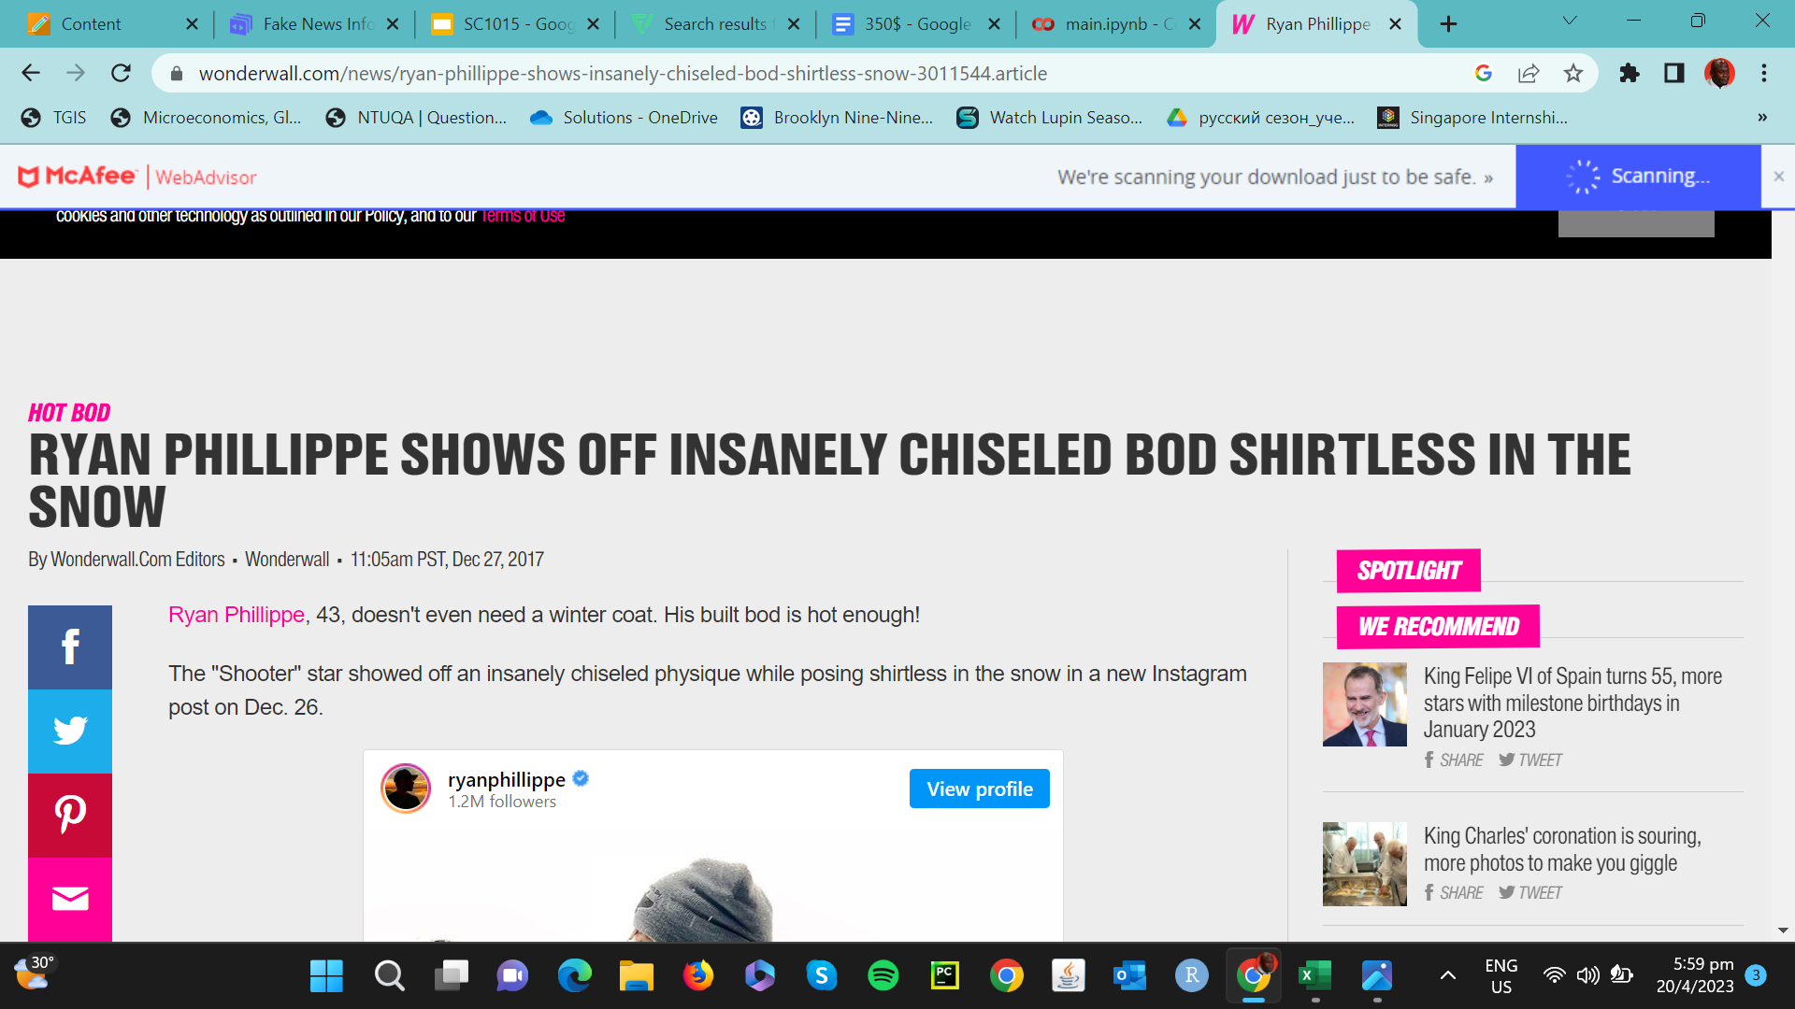
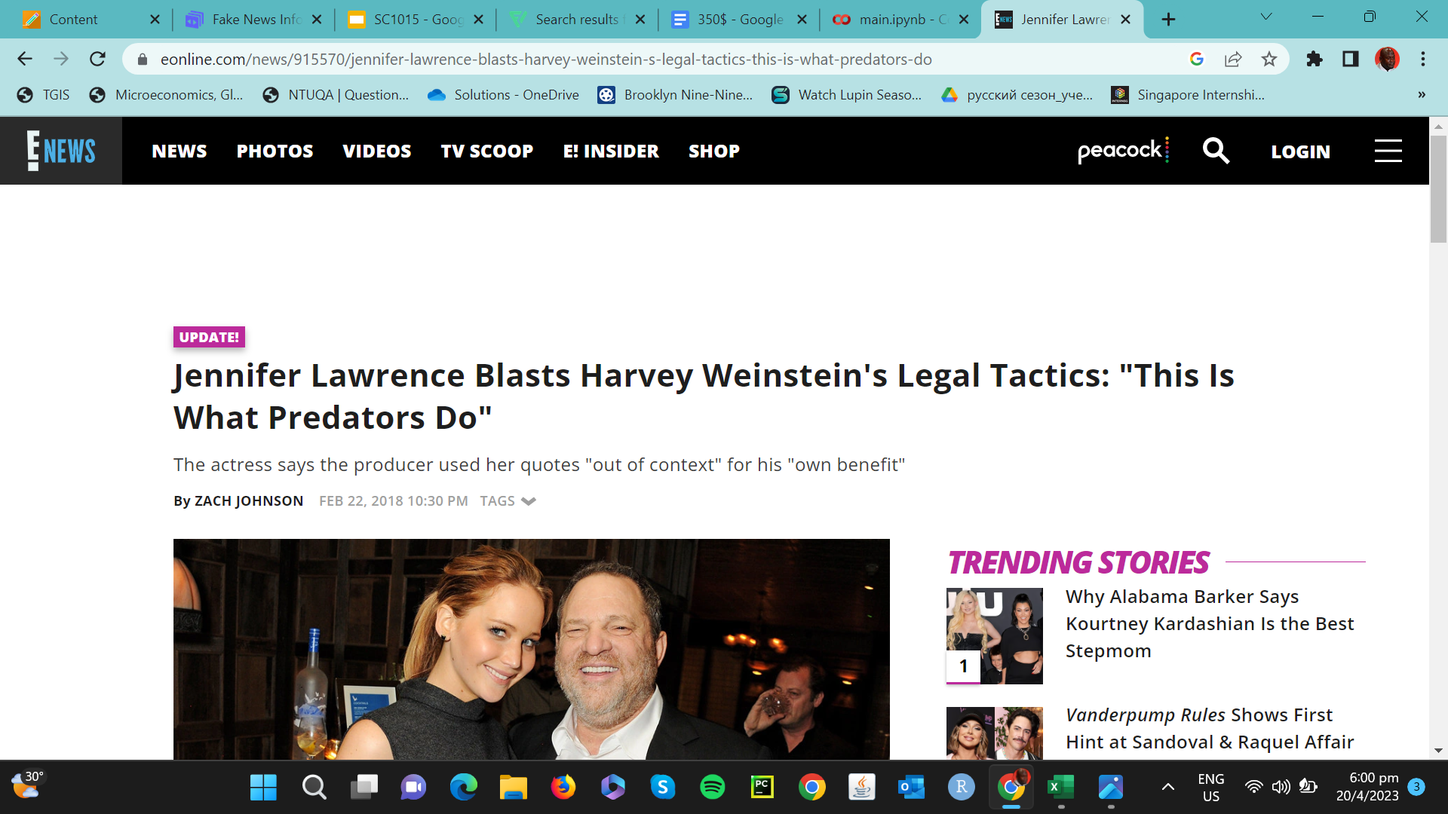
REAL OR FAKE??

Slide 4
Motivation
Monetary
Concerns
1
Widespread Panic and Suspicion
2
Loss of Trust in Journalism
3

Slide 5

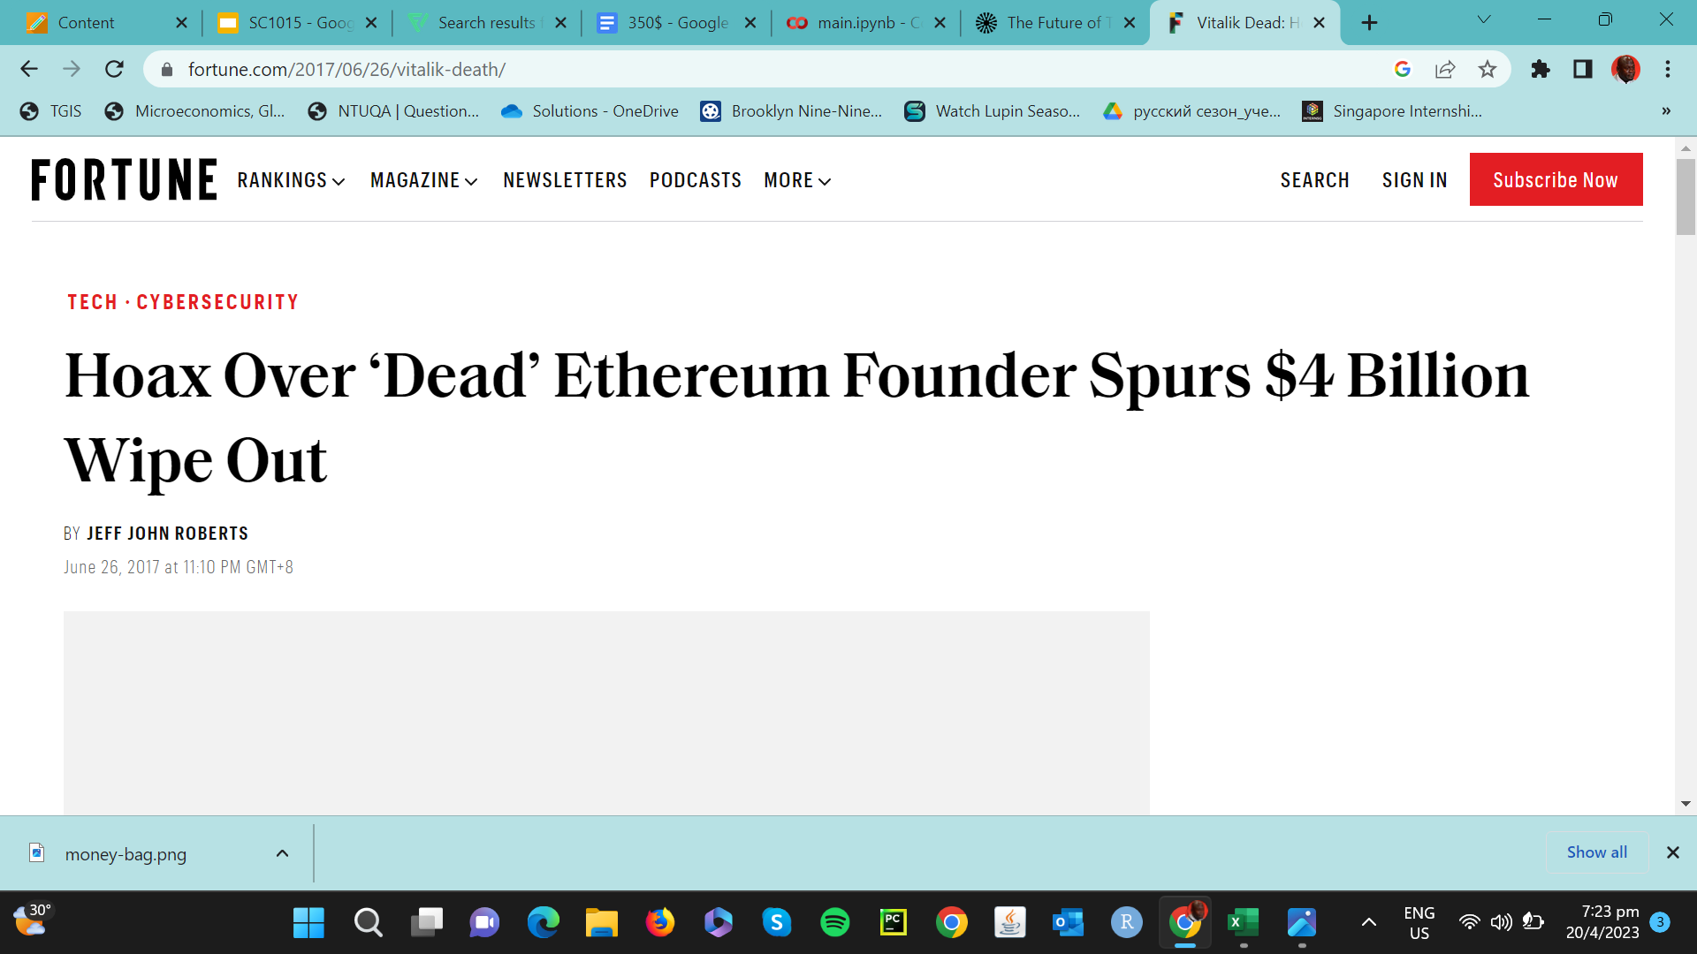
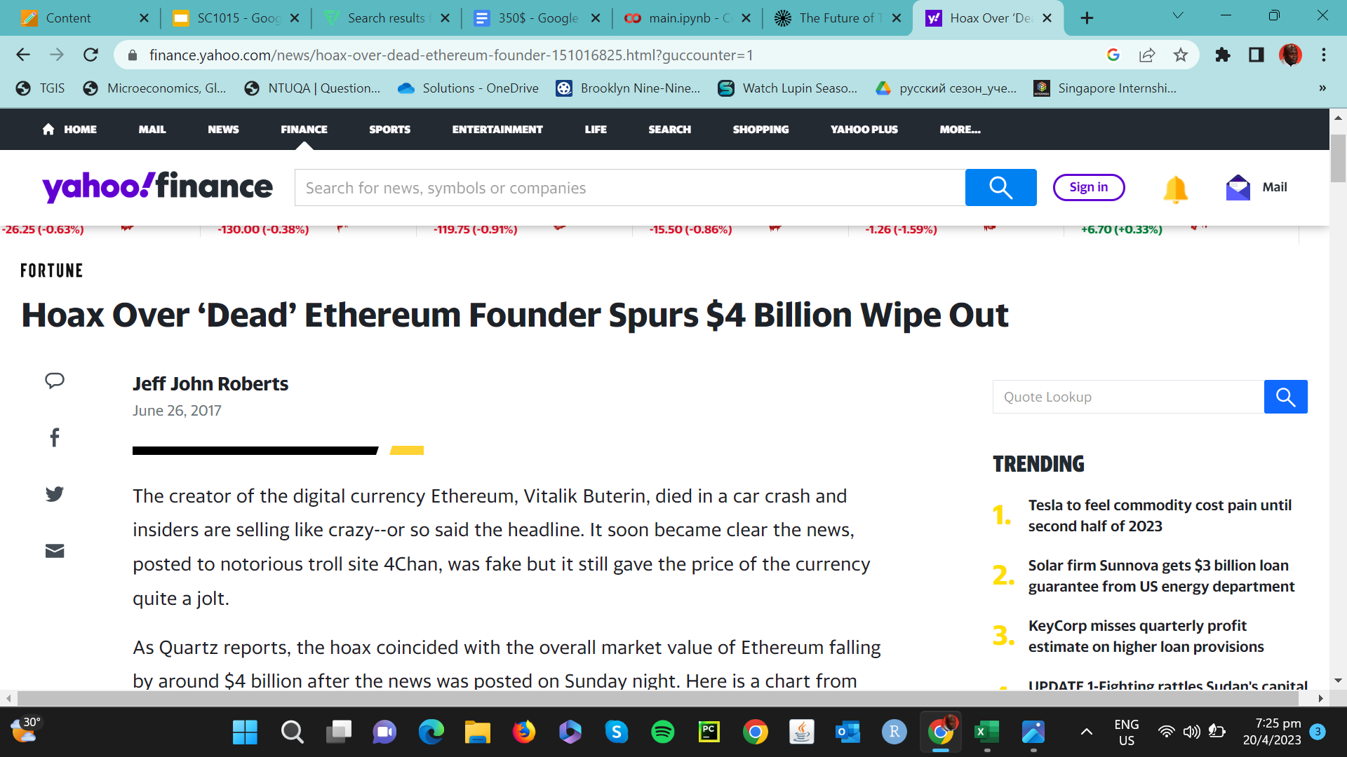
Monetary Concerns

Slide 6


Widespread Panic and Suspicions
E.g 2016 US Elections between Trump and Clinton
64% of adults
23% of adults
believe fake news stories cause a great deal of confusion
shared fabricated political stories themselves

Slide 7
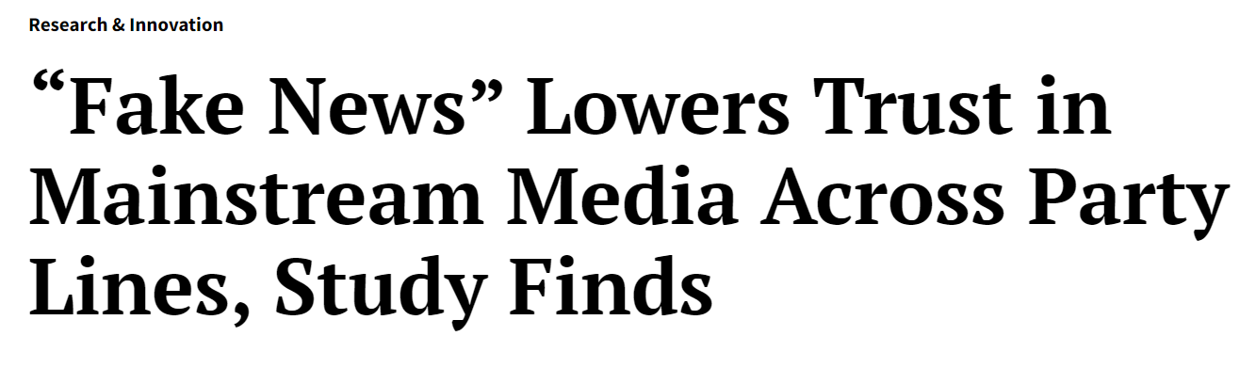


Loss of Trust in Journalism

Slide 8
Problem definition
To utilize machine learning algorithms that can accurately discern fake news from real news and analyse the factors that differentiate them.

Slide 9
Cleaning the dataset
1
2
3
Drop
Removing duplicates
Stop words
Redundant columns ‘news_url’ and ‘source_domain’
Removal of duplicates in message
Remove redundant words

Slide 10
Exploratory Data Analysis and Visualization

Slide 11
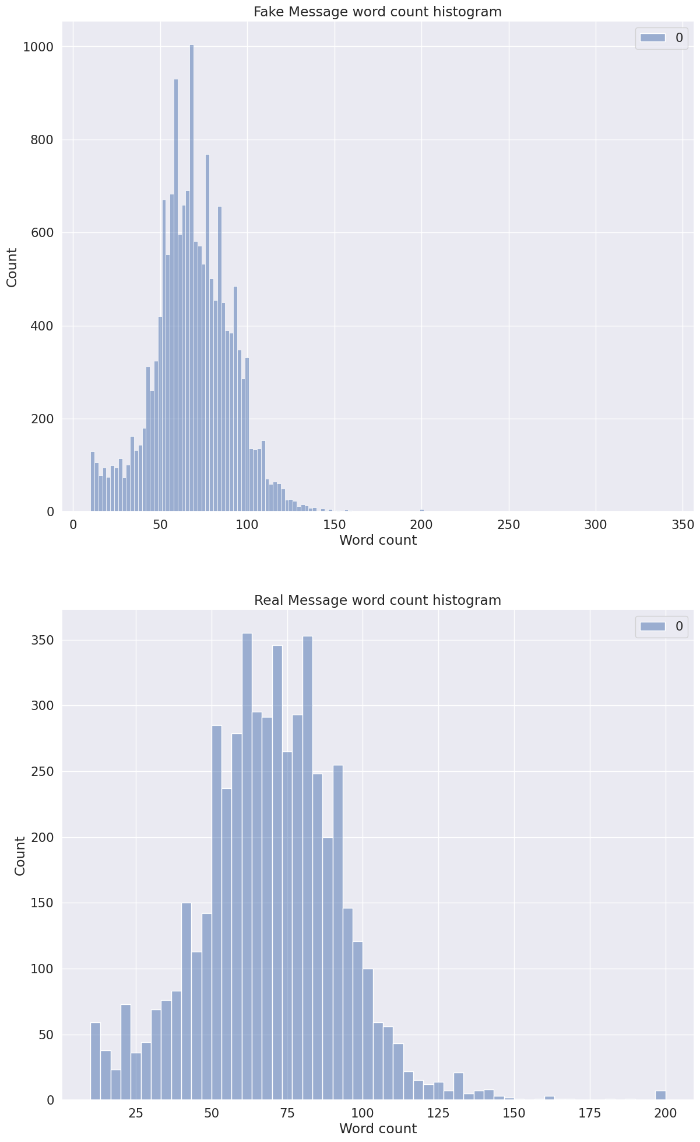
Word Count Analysis
Exploratory Data Analysis and Visualization
Analysis
Same average number of words
Similar dispersion in word count

Slide 12
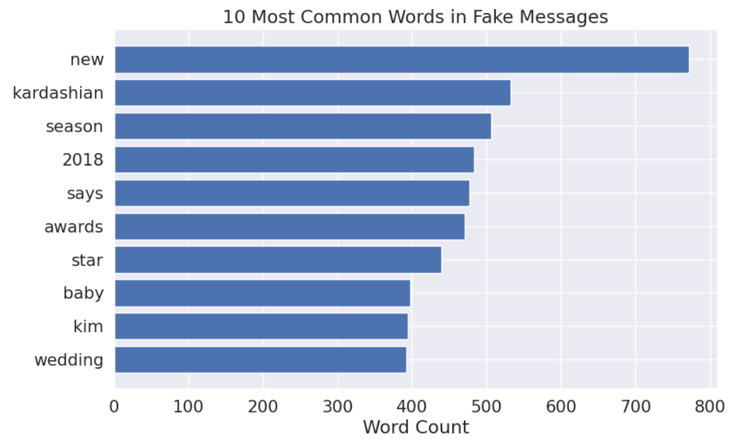
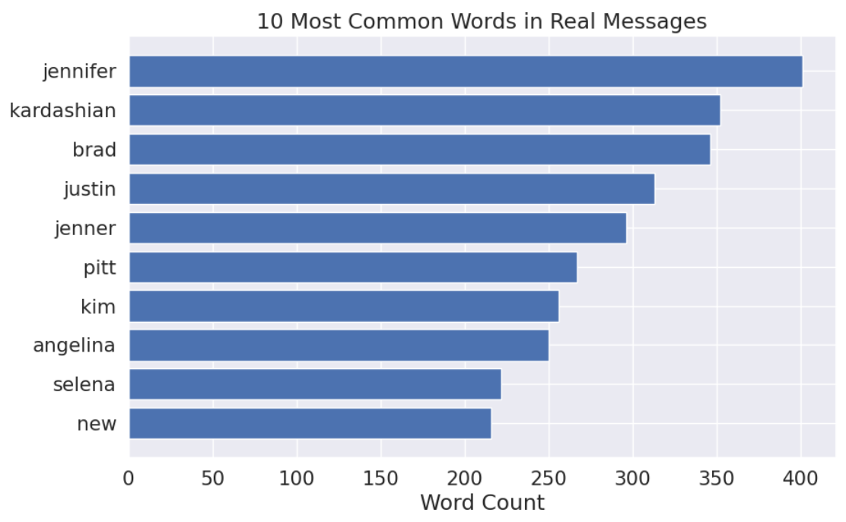
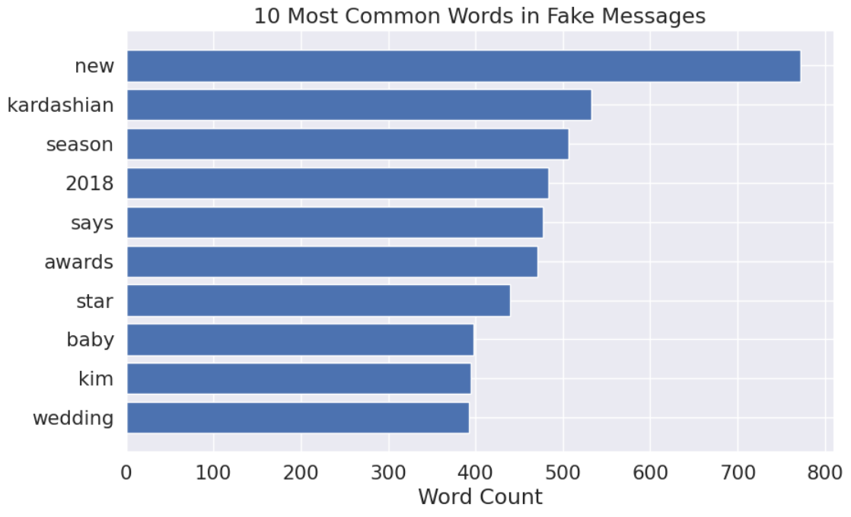
Bar graph for 10 most common words
Bar graph for 10 most common words in Fake Messages
Bar graph for 10 most common words in Real Messages

Slide 13
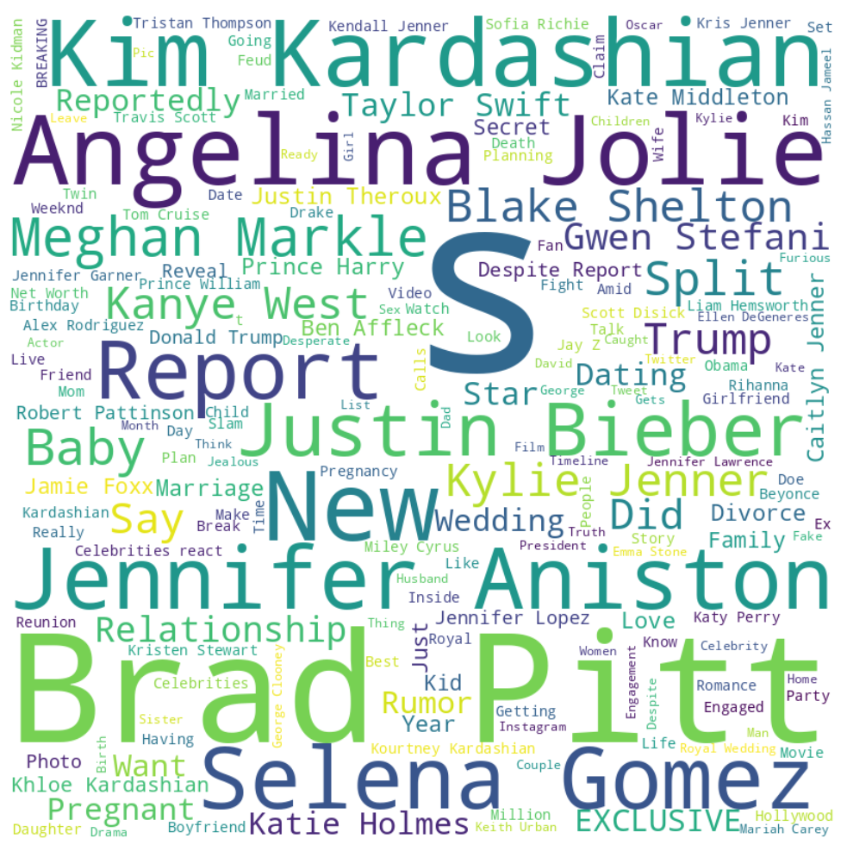
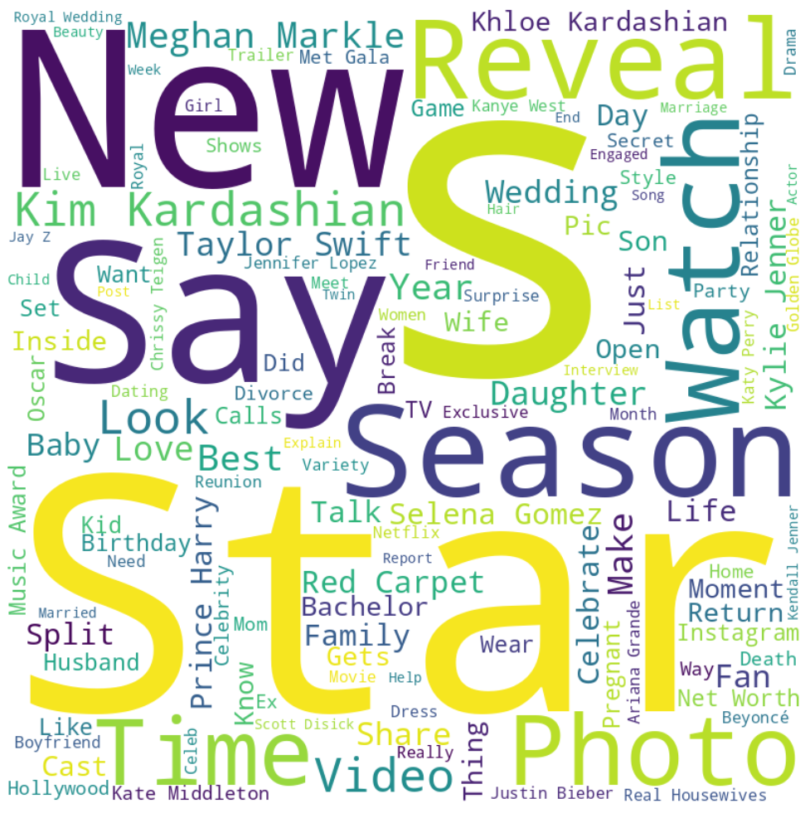
Word Cloud for 10 most common words in Real Messages
Word Cloud for 10 most common words in Fake Messages

Slide 14
ML Models Used
Naive-Bayes
1
Random Forest Regression
2

Slide 15
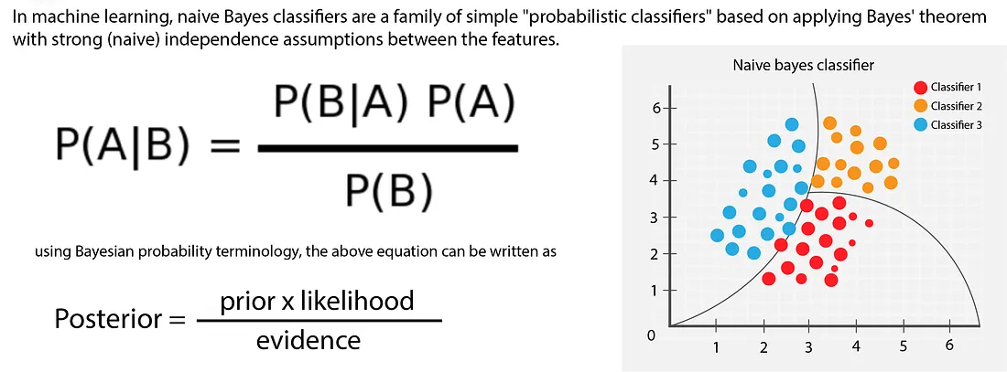
First Model: Naive-Bayes

Slide 16
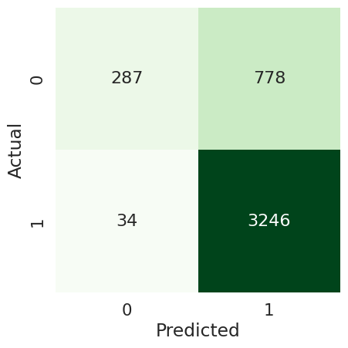
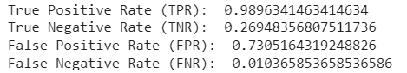
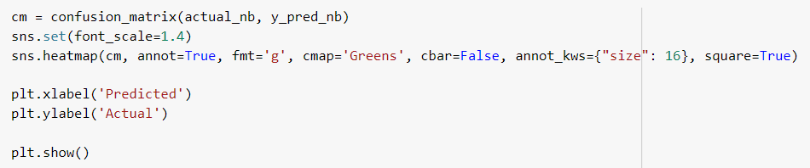
Naive Bayes Code

Slide 17
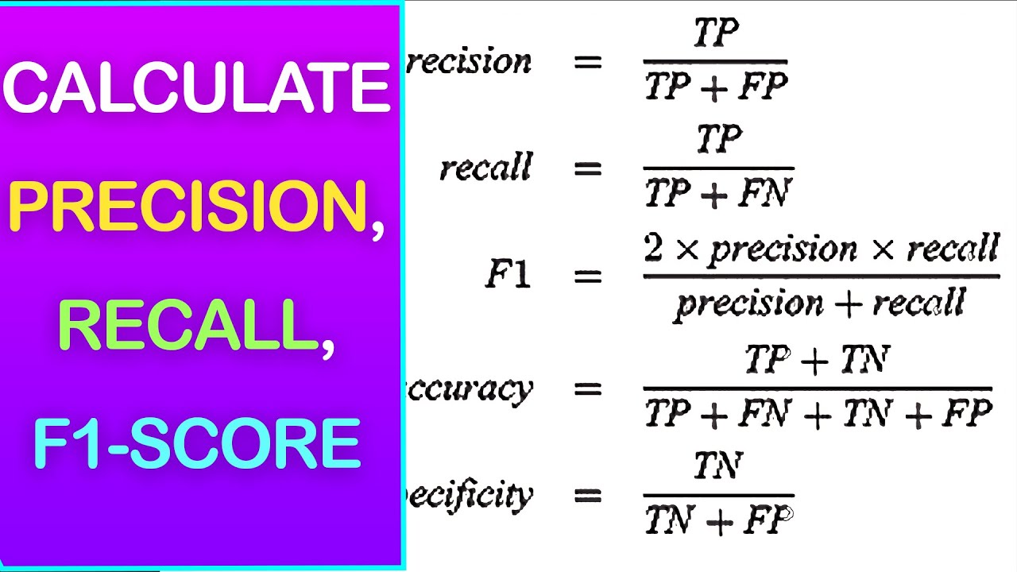
Naive Bayes Model
Calculation based on probabilities of each word:
Accuracy:
0.81312
F1 Score:
0.88883
Accuracy = Correct predictions/Total predictions

Slide 18
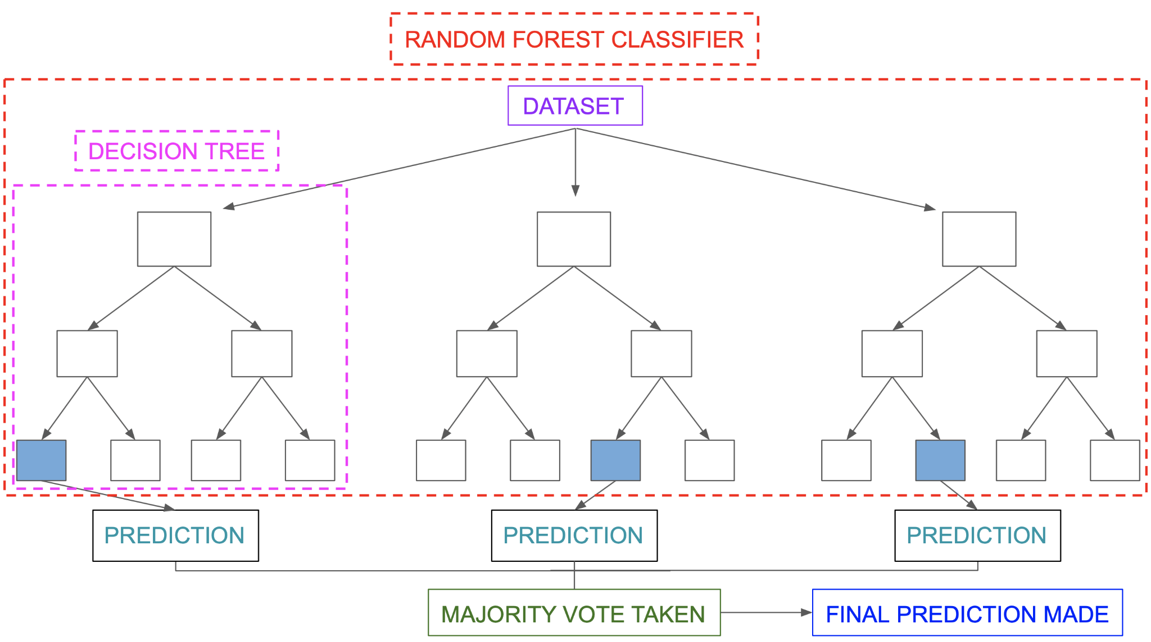
Second Model: Random Forest Regression

Slide 19
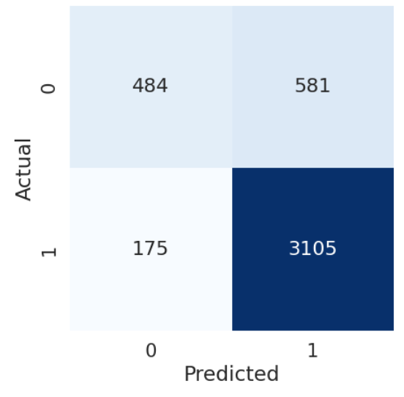
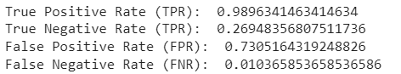
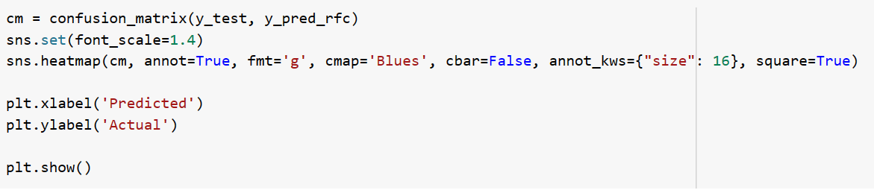
Random Forest Classifier

Slide 20
Random Forest Classifier
Calculation based on probabilities of each word:
Accuracy:
0.82601
F1 Score:
0.89147
Accuracy = Correct predictions/Total predictions

Slide 21
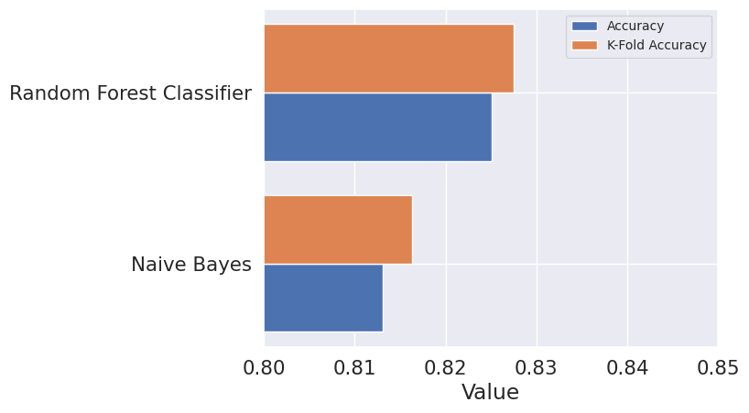
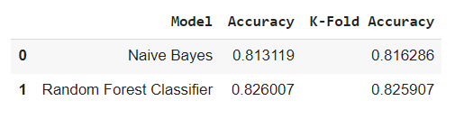
K-Fold
Resampling Method to determine more accurate performance measure

Slide 22
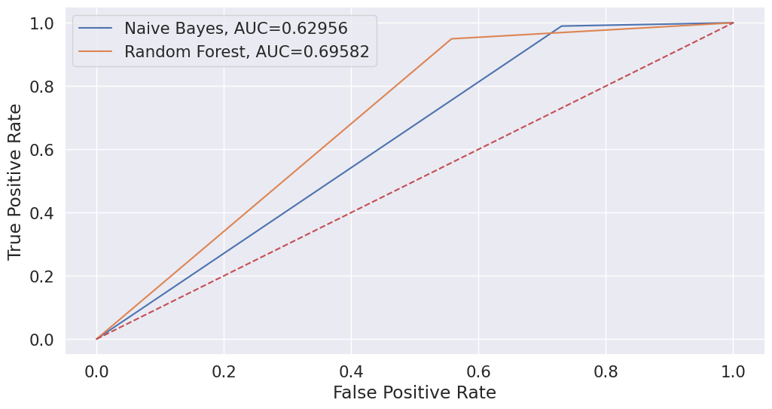
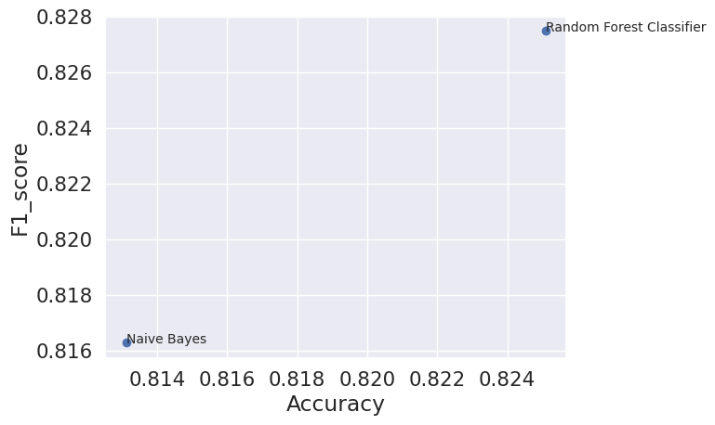
ROC Curve
Larger Area = Better Indicator
Random Forest is a better indicator

Slide 23
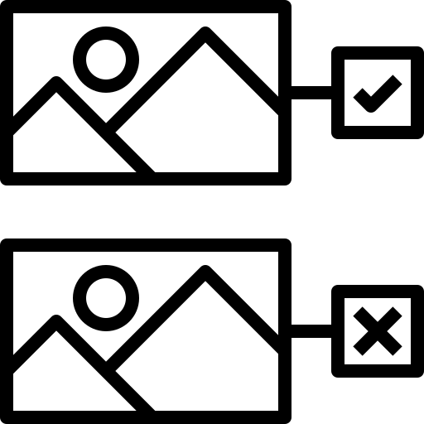

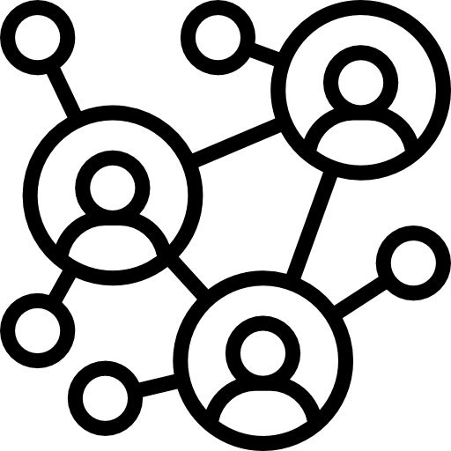

Conclusion
1
2
3
4
Possible to predict fake and real news using ML models to a large extent
More balanced dataset will reduce biases and improve accuracy score
Explore different models such as neural networks
Feedback System to improve learning

Slide 24
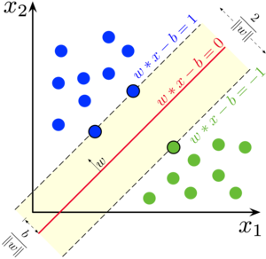
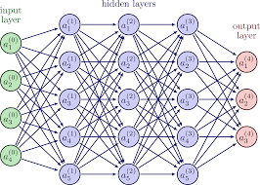
Alternative ML Models
Neural Network
Support Vector Machine (SVM)

Slide 25

Feedback Learning System
Improve learning through user’s feedback
Similar to ChatGPT
Identify patterns and areas for
improvement

Slide 26

A135 Team 5
NAME MATRICULATION NO NAME MATRICULATION NO NAME MATRICULATION NO

Slide 27
References
Ukraine war: five of the most viral misinformation posts and false claims since the conflict. (2022, August 24). Euronews. Retrieved from https://www.euronews.com/my-europe/2022/08/24/ukraine-war-five-of-the-most-viral-misinformation-posts-and-false-claims-since-the-conflic
Paudel, R. (2021, June 28). Introduction to Naïve Bayes Classifier. Towards Data Science. Retrieved from https://towardsdatascience.com/introduction-to-na%C3%AFve-bayes-classifier-fa59e3e24aaf
Rovatsos, M. (2021, June 10). Introduction to Random Forest in Machine Learning. Section. Retrieved from https://www.section.io/engineering-education/introduction-to-random-forest-in-machine-learning/
Anderson, M., & Barthel, M. (2017, October 19). The future of truth and misinformation online. Pew Research Center. Retrieved from https://www.pewresearch.org/internet/2017/10/19/the-future-of-truth-and-misinformation-online/
Rutgers University. (2017, October 18). Fake news lowers trust in mainstream media across party lines, study finds. ScienceDaily. Retrieved from https://www.sciencedaily.com/releases/2017/10/171018130347.htm
Neural Network Example. (n.d.). TikZ.net. Retrieved from https://tikz.net/neural_networks/
Support vector machine. (2022, April 11). In Wikipedia. Retrieved from https://en.wikipedia.org/wiki/Support_vector_machine
What is ChatGPT? (n.d.). Klippa. Retrieved from https://www.klippa.com/en/blog/information/what-is-chatgpt/

